Slide 1
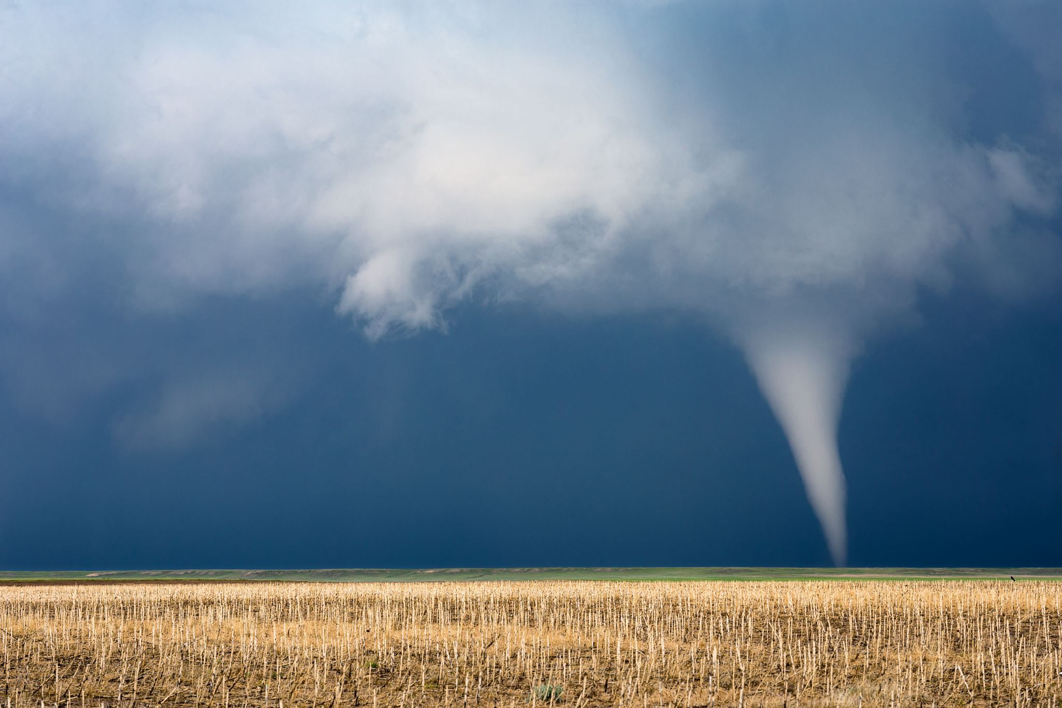
Rainfall Prediction using machine learning

Slide 2
Contents
Abstract
Introduction
Objectives
Significance
Challenges
Intro to ML
Algorithms
Tech Stack
Advantages
Architecture
Future scope
Conclusion

Slide 3
Abstract
Our project, "Rainfall Prediction using Machine Learning," addresses the imperative need for precise and timely rainfall forecasts. The unpredictability of weather patterns, especially in terms of rainfall, has significant implications for sectors such as agriculture, water resource management, and disaster preparedness. Traditional meteorological methods often fall short in providing accurate predictions, necessitating a paradigm shift towards innovative approaches.
In this project, we employ machine learning algorithms, specifically XGBoost and RandomForest, to leverage the potential of data-driven predictions. By analyzing atmospheric factors, we aim to develop a robust model capable of enhancing the accuracy of rainfall forecasts. The project's significance lies in its potential to contribute to more informed decision-making processes, empowering stakeholders in various sectors to proactively respond to dynamic weather conditions.
Through this abstract, we invite you to delve into the methodologies, challenges faced, and outcomes achieved in our pursuit of revolutionizing rainfall prediction. Join us on this journey as we present a comprehensive overview of our machine learning-based approach and its implications for the broader field of weather forecasting.

Slide 4
Introduction
§Rainfall forecasting is a critical aspect of climate prediction, influencing sectors such as agriculture, water resource management, and disaster preparedness. Traditional methods, often reliant on meteorological approaches, face challenges in providing accurate and timely predictions.

Slide 5

OBJECTIVES
Our project aims to predictive model for estimating rainfall amounts based on weather data such as temperature, humidity, and wind speed. Machine learning models offer the potential to improve the accuracy of rainfall predictions based on various atmospheric factors.

Slide 6
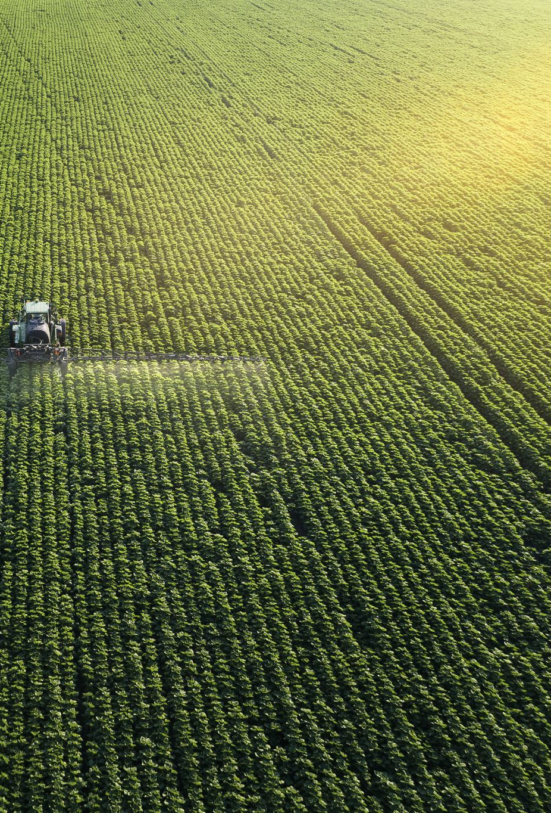
Significance
Accurate rainfall prediction is crucial for making informed decisions in agriculture, water resource allocation, and disaster planning. By harnessing the power of machine learning, we seek to contribute to advancements in weather forecasting.

Slide 7

Challanges
1.Data Availability and Quality:
Obtaining a comprehensive and reliable dataset for rainfall prediction posed a significant challenge.
Curating the dataset required meticulous efforts to ensure the inclusion of diverse atmospheric conditions.
2.Algorithmic Complexity:
Selecting and fine-tuning machine learning algorithms suitable for predicting complex weather patterns was a challenging task.
Balancing model accuracy with computational efficiency involved careful considerations of feature selection and algorithm parameters.
3.Data Imbalance:
Addressing data imbalance in weather prediction datasets was crucial for model performance.
Implementation of the RandomOverSampler technique was necessary to ensure a balanced representation of positive and negative rainfall instances.

Slide 8
Cont...
4. Dynamic Atmospheric Conditions:
The dynamic and ever-changing nature of atmospheric conditions introduced unpredictability.
Continuous model updates and optimizations were required to adapt to evolving weather patterns.
5. Technical Skill Development:
Overcoming these challenges contributed to the refinement of our technical skills.
Tackling complex issues deepened our understanding of the intricacies involved in applying machine learning to weather prediction.
6. Continuous Model Optimization:
The need for continuous optimization and updates to the model highlighted the ongoing nature of weather prediction model development.
Adaptive strategies were employed to ensure the model remained effective in the face of dynamic atmospheric changes.

Slide 9
Intro to ML
Machine Learning is a branch of artificial intelligence (AI) that focuses on developing algorithms and statistical models that enable computers to perform tasks without explicit programming instructions. Instead, ML algorithms learn from data, identify patterns, and make predictions or decisions based on the learned patterns.

Slide 10
Key concepts in ML
Data: Data is the foundation of machine learning. ML algorithms require a large amount of data to learn patterns and make accurate predictions. Data can come in various forms, including structured data (tabular data), unstructured data (text, images, audio), and semi-structured data (JSON, XML).
Features and Labels: In supervised learning, the dataset consists of input features (attributes) and corresponding labels (outputs or target variables). The goal is to learn the relationship between the features and labels to make predictions on new data.

Slide 11

algorithms
Random Forest Algorithm:
Random Forest is an ensemble learning method that operates by constructing a multitude of decision trees during training and outputting the average prediction of the individual trees for regression tasks. It builds multiple decision trees and merges them together to get a more accurate and stable prediction..
Key Features:
Ensemble Learning: Random Forest is an ensemble learning method that combines the predictions of multiple individual decision trees to produce a final prediction. This ensemble approach helps improve prediction accuracy and generalization.
Decision Trees: At the core of the Random Forest algorithm are decision trees, which are constructed based on feature splits that optimize certain criteria (e.g., Gini impurity for classification, mean squared error for regression). Each decision tree in the forest is trained independently on a random subset of the training data.
Random Sampling: Random Forest employs a technique called bootstrapping, where random samples of the training dataset are drawn with replacement. This random sampling ensures that each decision tree in the forest sees a slightly different subset of the data, promoting diversity among the trees.

Slide 12
Cont...
Advantages:
It can handle large datasets with high dimensionality and many features.
It is robust to overfitting, thanks to the averaging effect of multiple trees.
It provides estimates of feature importance, allowing for insight into the most influential features.
It is relatively insensitive to outliers and noise in the data.

Slide 13
Tech Stack
Programming Language: Python
Libraries: pandas
Numpy
Matplotlib/Seaborn
Scikit-Learn
XGBoost
Imbalanced-Learn
Development Environment: Pycharm
Version Control: Git
Documentation: MS Word

Slide 14
Advantages
1.Improved Accuracy:
Machine learning models excel in discerning complex patterns within datasets, leading to more accurate predictions compared to traditional methods.
2.Handling Non-linearity:
Atmospheric factors influencing rainfall often exhibit non-linear relationships. XGBoost and RandomForest are well-suited to capture these intricate patterns, enabling more nuanced predictions.
3.Ensemble Learning:
Both XGBoost and RandomForest leverage ensemble learning, combining the strengths of multiple models. This results in a more robust and reliable predictive model.
4.Feature Importance:
These algorithms provide insights into the importance of different atmospheric features, aiding in the identification of key factors contributing to rainfall.

Slide 15
Cont...
5.Scalability:
XGBoost and RandomForest can efficiently handle large datasets and high-dimensional feature spaces, ensuring scalability for diverse and extensive meteorological data.
6.Reduced Overfitting:
The inherent regularization techniques in XGBoost and the ensemble approach of RandomForest contribute to mitigating overfitting, enhancing the generalization capabilities of the model.
7.Parallel Processing:
XGBoost's parallel computing capabilities expedite model training, making it particularly advantageous for large-scale datasets.
8.Versatility:
These algorithms are versatile and applicable to various domains, showcasing their adaptability and effectiveness across different prediction tasks.

Slide 16
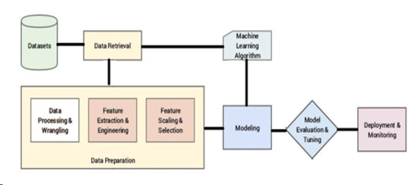
Architecture

Slide 17
Code sample
def get_weather_data(city, api_key): url = f"http://api.openweathermap.org/data/2.5/weather?q={city}&appid={api_key}" response = requests.get(url) if response.status_code == 200: data = response.json() return data else: print("Error fetching data:", response.status_code) return None

Slide 18
CONT..
def predict_rainfall(weather_data, model): temperature = weather_data['main']['temp'] humidity = weather_data['main']['humidity'] wind_speed = weather_data['wind']['speed'] # Create a DataFrame with the same column names as used during training # This ensures that feature names are provided when making predictions features = pd.DataFrame({'Temperature': [temperature], 'Humidity': [humidity], 'Wind_Speed': [wind_speed]}) rainfall_prediction = model.predict(features) return rainfall_prediction[0]

Slide 19

Code output

Slide 20
Results
Training and Evaluation Summary:
Briefly mention the dataset used for training the Random Forest model.
Highlight the training process and any hyperparameter tuning conducted.
Model Performance Evaluation:
Provide an overview of the model's performance evaluation metrics.
Predicted Rainfall and Humidity:
Display a table or visual representation showing predicted rainfall and humidity for different cities or time periods.
Include actual vs. predicted rainfall values for comparison.

Slide 21
Future Scope
Deployment in Cloud Environment:
Deploy the prediction model in a cloud-based environment (e.g., AWS, Azure) to leverage scalability, reliability, and cost-effectiveness. This would enable seamless access to the prediction service from anywhere
Real-Time Prediction and Monitoring:
Develop a real-time prediction and monitoring system that continuously collects live weather data and provides up-to-date rainfall predictions for specific locations. This could be useful for agricultural planning, flood monitoring, or emergency response.

Slide 22
Reference links
https://www.geeksforgeeks.org/rainfall-prediction-using-machine-learning-python/amp/
https://thecleverprogrammer.com/2020/09/11/rainfall-prediction-with-machine-learning/

Slide 23
Conclusion
Using machine learning to predict rainfall gives us accurate forecasts. These forecasts help in farming and managing disasters. To succeed, we need good data, choose the right features, and optimize our models. This work has the potential to solve real problems and teach us more about weather and the environment.

Slide 24
THANK YOU

